Slide 1
Information Retrieval
W266: Natural Language Processing

Slide 2
Announcements
Semester is wrapping up…
Any midpoints submitted so far will be returned before the weekend.
If you don’t hear from us by 11:59pm on Friday, please ping!
Timeline:
December 3: A4 due
December 7: Project

Slide 3
Feedback!
End of semester feedback is now open!
James is working on significant changes over the winter and launching in the summer. If you have ideas, please feel free to *also* reach out if your ideas don’t fit the feedback template.

Slide 4
The plan...
IR
Overview
Infrastructure
Ranking and Evaluation

Slide 5
Checking in on the Async...
Group exercise...

Slide 6
Edit distance
What is the edit distance of "peach" and "patch"?

Slide 7
Edit distance
2
What is the edit distance of "peach" and "patch"?

Slide 8
Spelling correction
The noisy channel spelling model computes the unnormalized probability P(believe|beleiv) as the product of what terms?

Slide 9
Spelling correction
p(typed | intended) x p(intended)
Unnormalized as we ignore the p(typed) in the denominator. Why can we do this?
The noisy channel spelling model computes the unnormalized probability P(intended|typed) as the product of what terms?

Slide 10
Tokenization
What do you think is the most serious problem with greedy segmentation algorithms (probabilistic or not)?

Slide 11
Positional Index
True or False? The original documents can be reconstructed from a positional index.

Slide 12
Positional Index
True!
True or False? The original documents can be reconstructed from a positional index.

Slide 13
Jaccard Coefficient
True or False? You could implement token-level Jaccard coefficient ranking using a nonpositional index.

Slide 14
Jaccard Coefficient
True
True or False? You could implement token-level Jaccard coefficient ranking using a nonpositional index.

Slide 15
tf-idf Ranking
True or False? IDF has no effect on ranking for one-word queries.

Slide 16
tf-idf Ranking
True
True or False? IDF has no effect on ranking for one-word queries.

Slide 17
Vector Space Model
True or False? A positional index has all the information necessary to compute TF-IDF scores.

Slide 18
Vector Space Model
True
True or False? A positional index has all the information necessary to compute TF-IDF scores.

Slide 19
Evaluating IR
True or False? The precision/recall curve ignores potentially relevant documents not in the top-k ranked results.

Slide 20
Evaluating IR
True
True or False? The precision/recall curve ignores potentially relevant documents not in the top-k ranked results.

Slide 21
Information Retrieval

Slide 22
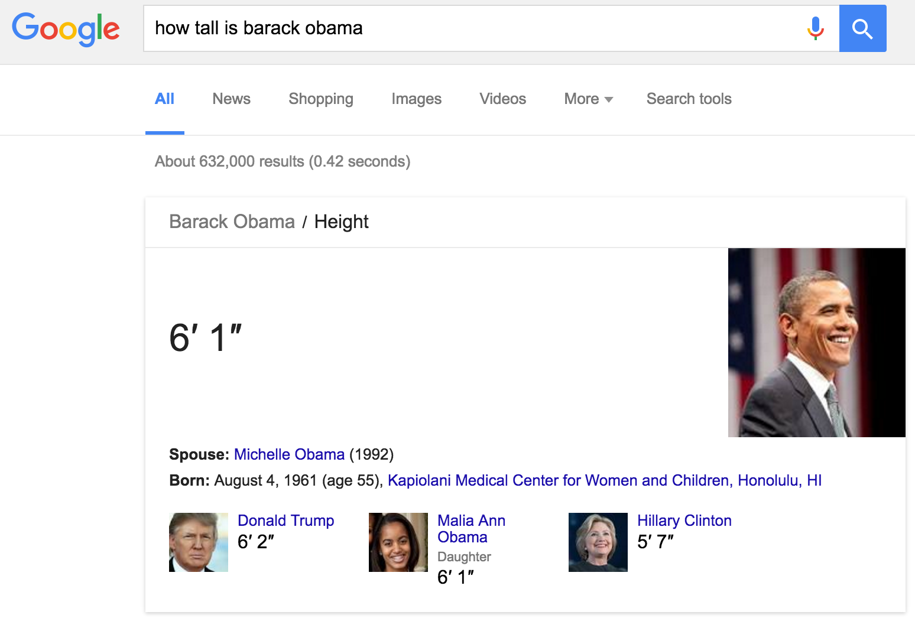

Slide 23
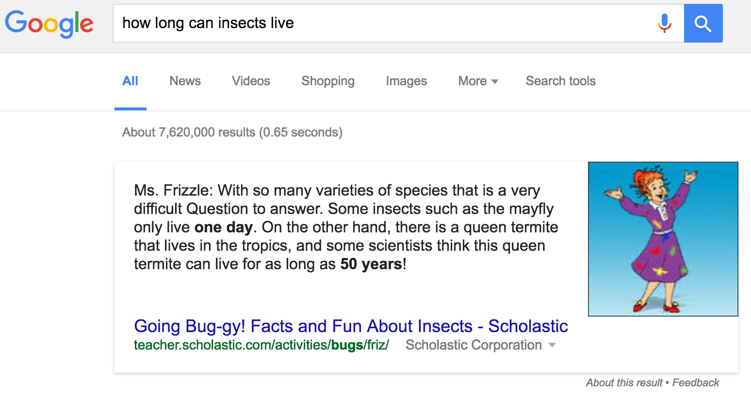

Slide 24
Information Retrieval
Find text, satisfy “information need”
Not quite NLP, but related and intertwined
NLP often critical component of IR
IR ideas often appear in NLP

Slide 25
NLP and IR
(Modern) IR uses lots of NLP techniques
Text (pre)-processing
Textual similarity
Entity identification and resolution
Structured interpretations / QA

Slide 26
IR and NLP
Challenges:
Huge amount of information! (the web)
Hard to evaluate “relevance”
Hard to measure recall
Similar challenges for many NLP tasks:
Summarization: what’s a good summary?
Question Answering: what’s a good answer?
Translation: good translation, might not match reference

Slide 27
IR Infrastructure & Implementation

Slide 28
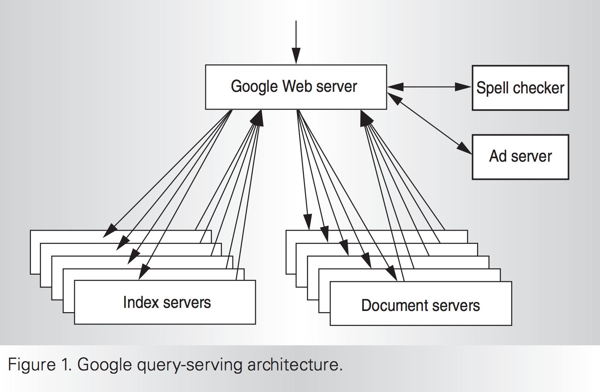
IR: Distributed Infrastructure
Notes:
Need to construct in a distributed manner too!

Slide 29
Notebook: simple search engine

Slide 30
Ranked Retrieval

Slide 31
tf.idf
Term Frequency (TF):
The number of times each query token appears in the document
Proxy: How relevant is this document to this word?
Inverse Document Frequency (IDF):
log N/n_{t}
Proxy: Balance between words

Slide 32
tf.idf
[hello]
IDF(hello) = 0.1
Doc 1 TF: 6
Doc 2 TF: 8
Does IDF matter?

Slide 33
tf.idf
[hello world]
IDF(hello) = 0.1
IDF(world) = 8
Doc 1 TF(hello): 20, TF(world): 0
Doc 2 TF(hello): 1, TF(world): 1
Does IDF matter?

Slide 34
Evaluation Metrics

Slide 35
Ranked Retrieval
How do we evaluate?
True: sorted list of (document, relevance)
Predict: sorted list of (document, predicted relevance)
Need to do ranking comparison! Many choices:
Mean Average Precision (MAP)
Kendall’s Tau, Spearman’s Rho
NDCG

Slide 36
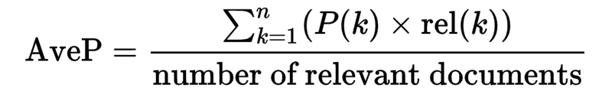
Mean Average Precision (MAP)
Mean Average Precision ~= AuPRC
Idea: average precision for retrieving each relevant document
MAP = average of AvpP over all queries

Slide 37
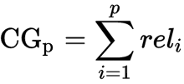
Cumulative Gain

Slide 38
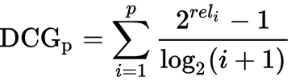
Discounted Cumulative Gain
There are two common formulations of this...

Slide 39
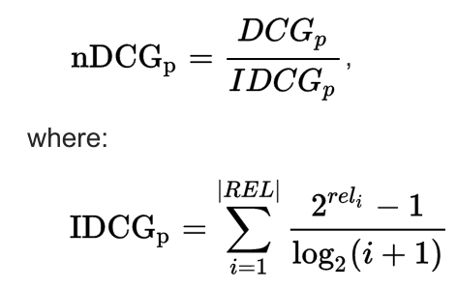
Normalized Discounted Cumulative Gain

Slide 40
Rank Correlation
Kendall’s Tau: pairwise ordering accuracy
Consider all pairs (x_{i}, x_{j}) with scores y_{i}, y_{j}
𝝉 = (# pairs correctly ordered - # pairs incorrectly ordered) / (# total pairs)
Spearman’s Rho: rank correlation
Rank true scores, predicted scores
Compute Pearson correlation between lists of ranks
Ex: true = [1,2,3,4], pred = [3,2,1,4]

